Slide 1

INSTITUTE - UIE
DEPARTMENT- ACADEMIC UNIT-2
Bachelor of Engineering (Computer Science & Engineering)
Subject Name: Introduction to Problem Solving
Code:22CSH-101
Array & Strings
DISCOVER . LEARN . EMPOWER

Slide 2

OBJECTIVES
The course aims to provide exposure to problem solving with programming
The course aims to raise the programming skills of students via logic building capability
With the knowledge of C language students would be able to model real world problems
OBJECTIVES

Slide 3



CO Number | Course Outcome
CO1 | Remember the concepts related to fundamentals of C language, draw flowcharts and write algorithm/pseudocode.
CO2 | Understand the way of execution and debug programs in C language.
CO3 | Apply various constructs, loops, functions to solve mathematical and scientific problem.
CO4 | Analyze the dynamic behavior of memory by the use of pointers.
CO5 | Design and develop modular programs for real world problems using control structure and selection structure.

Slide 4
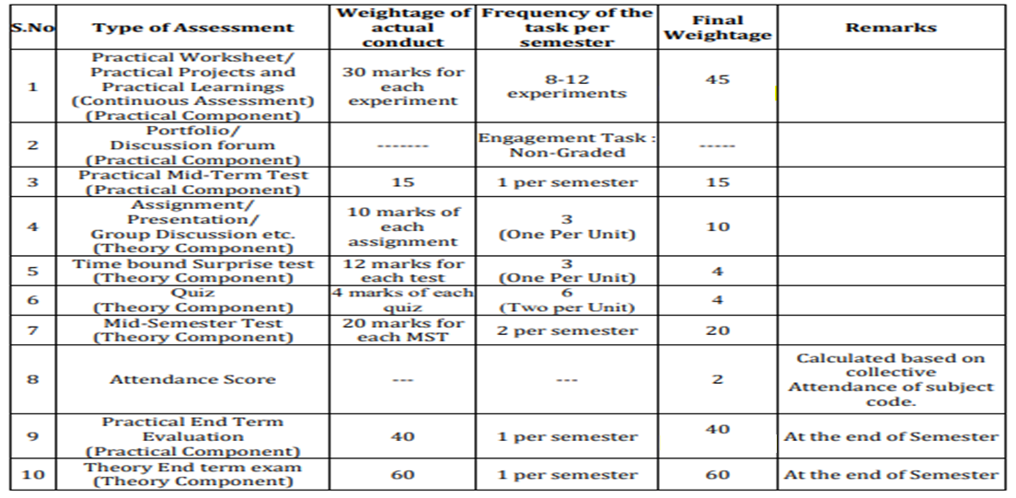
Scheme of Evaluation

Slide 5
Content
Two Dimensional Array
Initialization of Two Dimensional Array
Memory Representation of 2D Array
Examples
References

Slide 6
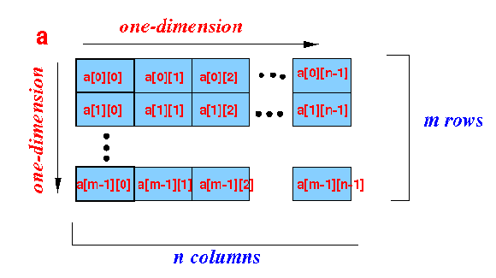
2-Dimensional Array
A two-dimensional array is an array where its elements are selected (identified) using two indices. In 2-D array, to declare and access elements of a 2-D array we use 2 subscripts instead of 1.
Syntax: data_type array_name[ROW][COL];
The total number of elements in a 2-D array is ROW*COL.
Example: int a[m][n];
In rectangular 2-dimensional arrays, m number of rows and n number of columns in the array has the same number of array elements.
A conceptual representation of 2D array

Slide 7
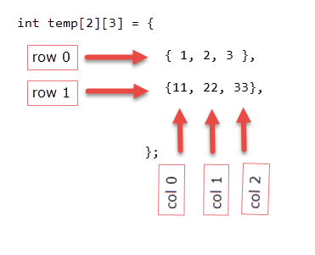
Initialization of two-dimensional array: Initialization of 2-D array is similar to a 1-D array.
Example:
Initialization 2-D Array
After this initialization, each element is as follows:
temp[0][0] : 1
temp[0][1] : 2
temp[0][2] : 3
temp[1][0] : 11
temp[1][1] : 22
temp[1][2] : 33

Slide 8
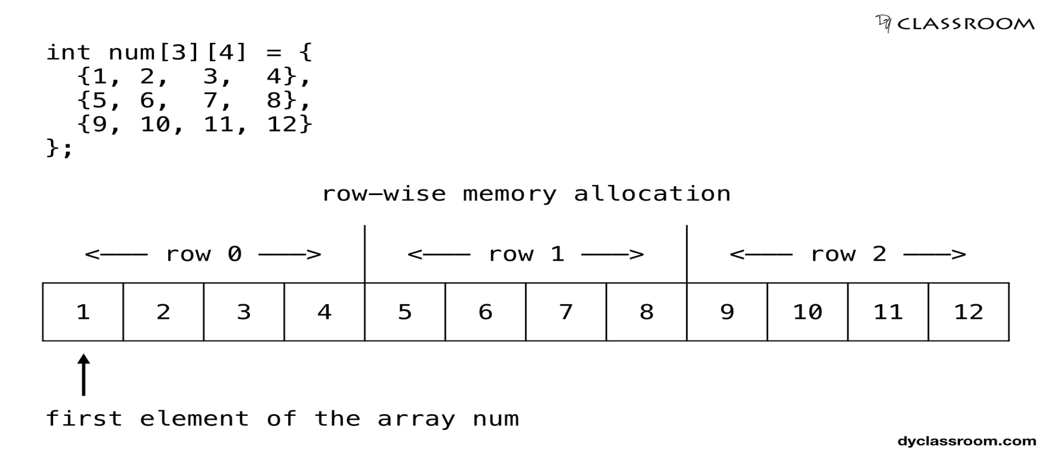
Memory Representation 2-D Array
The compiler will allocate the memory for two dimensional array row-wise meaning the first element of the second row will be placed after the last element of the first row.

Slide 9
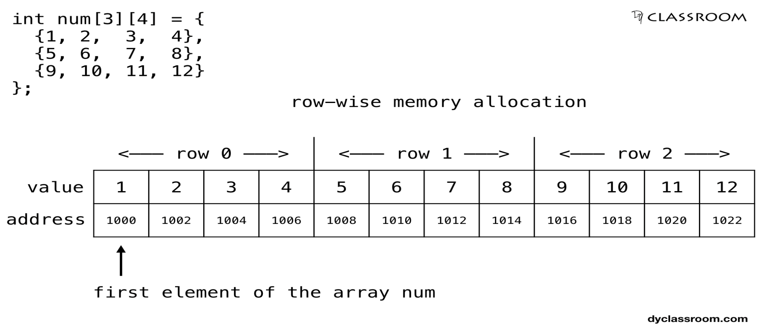
Memory Representation 2-D Array
And if we assume that the first element of the array is at address 1000 and the size of type int is 2 bytes then the elements of the array will get the following allocated memory locations.

Slide 10
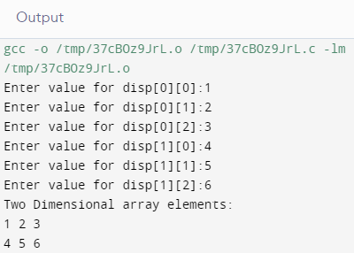
1. Program to store the elements from the user and store them in an 2D array.
#include<stdio.h>
int main()
{
int disp[2][3], i, j;
for(i=0; i<2; i++)
{
for(j=0;j<3;j++)
{
printf("Enter value for disp[%d][%d]:", i, j);
scanf("%d", &disp[i][j]);
}
}
printf("Two Dimensional array elements:\n");
for(i=0; i<2; i++)
{
for(j=0;j<3;j++)
{
printf("%d ", disp[i][j]);
if(j==2){ printf("\n");
}
}
}
return 0;
}
Examples of 2-D Array

Slide 11
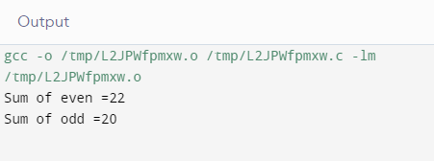
2.. Program to sum of even and odd of 2D array.
#include<stdio.h>
int main()
{
int i=0,j=0;
int arr[3][4]={{1,2,3,4},{2,3,4,5},{3,4,5,6}};
int even=0;int odd=0;
for(i=0;i<3;i++)
{
for(j=0;j<4;j++)
{
if(arr[i][j]%2==0)
{
even=even+arr[i][j];
}
else
{
odd=odd+arr[i][j];
}
}
}
printf("Sum of even =%d \n",even);
printf("Sum of odd =%d",odd);
return 0; }
Examples of
2-D Array

Slide 12
1.
In 2-D array, to declare and access elements of a 2-D array we use 2 subscripts instead of 1.
SUMMARY
2.
3.
In rectangular 2-dimensional arrays, m number of rows and n number of columns in the array has the same number of array elements.
The compiler will allocate the memory for two dimensional array row-wise meaning the first element of the second row will be placed after the last element of the first row.

Slide 13
FREQUENTLY ASKED QUESTIONS
PROGRAMS
Write a C Program to addition of two matrices.
Write a program in C to calculate determinant of a 3 x 3 matrix.
Write a program in C to accept two matrices and check whether they are equal.
Write a C program to transpose of two matrices.
Program to multiply two matrices.

Slide 14
UTILISE YOUR KNOWLEDGE TO ANSWER
1.Which of the following is true about arrays in C.
(A) For every type T, there can be an array of T. (B) For every type T except void and function type, there can be an array of T. (C) When an array is passed to a function, C compiler creates a copy of array. (D) 2D arrays are stored in column major form
2. What will be the output of the following C code?
#include <stdio.h>
void f(int a[][3])
{
a[0][1] = 3;
int i = 0, j = 0;
for (i = 0; i < 2; i++)
for (j = 0; j < 3; j++)
printf("%d", a[i][j]);
}
void main()
{
int a[2][3] = {0};
f(a);
}
a) 0 3 0 0 0 0 b) Junk 3 junk junk junk junk c) Compile time error d) All junk values
Let us see how much you have learned from the lecture and how effectively you can apply your knowledge…!!

Slide 15
UTILISE YOUR KNOWLEDGE TO ANSWER
3. What will be the output of the following C code?
#include <stdio.h>
void main()
{
int a[2][3] = {1, 2, 3, 4, 5};
int i = 0, j = 0;
for (i = 0; i < 2; i++)
for (j = 0; j < 3; j++)
printf("%d", a[i][j]);
}
a) 1 2 3 4 5 0 b) 1 2 3 4 5 junk c) 1 2 3 4 5 5 d) Run time error
Let us see how much you have learned from the lecture and how effectively you can apply your knowledge…!!

Slide 16
REFERENCES
Book References:
[1] Thareja Reema (2014) Programming in C. 2nd ed.
[2] Zed A. Shaw, Learn C the Hard Way’
[3] https://en.wikibooks.org/wiki/C_Programming
Vedio Lecture: https://nptel.ac.in/courses/106/105/106105171/
https://nptel.ac.in/courses/106/106/106106127/
https://spoken-tutorial.org/watch/C+and+Cpp/Working+With+2D+Arrays/English/
Websites: https://beginnersbook.com/2014/01/2d-arrays-in-c-example/
https://processing.org/tutorials/2darray/
https://www.programiz.com/c-programming/c-multi-dimensional-arrays
BOOKS
WEBSITES
COURSES

Slide 17

THANK YOU

